Slide 1

AB InBev Strategic Market Analysis on the Impact of MicroBreweries to Market Share
By: Team DataTex

Slide 2
Introduction
As of the latest 2015 data, AB InBev enjoys a 45.8% Share of the US beer market. While the merger with InBev has made Anheuser-Busch the largest brewer in America, when aggregate data is considered AB InBev has in fact seen a total reduction of 1.4% in its share of the US beer market when compared to 2014 data, this despite the fact that worldwide, AB InBev has seen a steady growth in market share. One factor for this may be the growing micro brew movement and the influx of craft beers into the market. AB InBev’s market strategy has been and continues to be the marketing and support of its core Brands and segment growth through acquisition of established brands. However, an analysis of market competition seems to indicates that the micro brew movement has grown from a novelty product to a serious brand competitor. This analysis will explore AB InBev’s emerging competition by analyzing the breweries and beers currently competing for US consumers.

Slide 3
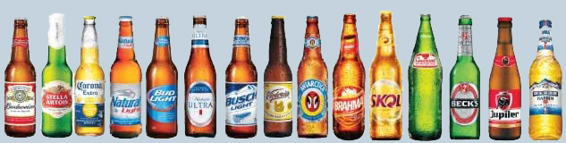
The Data
Breweries <- read.csv("C:/CaseStudy1/Breweries.csv", header = TRUE, sep = ",")
DataSet of 558 US Microbreweries
Beers <- read.csv("C:/CaseStudy1/Beers.csv", header = TRUE, sep = ",")
Dataset of 2410 US Craft Beers

Slide 4
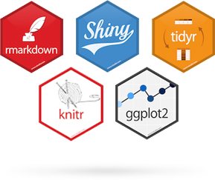

Analysis Tools for R-Studio
library(dplyr)
library(knitr)
library(rvest)
library(ggplot2)
library(psych)
library(maps)
library(plyr)

Slide 5
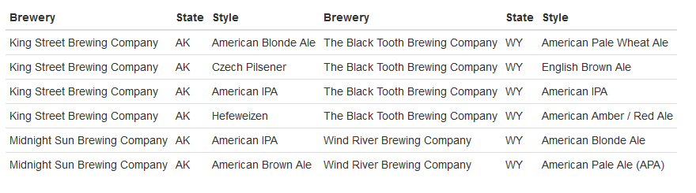




From Alaska to Wyoming A Revolution is Brewing
beers <- BeerData[c(1,3,5)]
Alaska <- head(beers,7)
P1 <- Alaska[2:7, ]
Wyoming <- tail(beers)
P2 <- Wyoming[1:6, ]
knitr::kable(list(P1, P2), row.names = FALSE)

Slide 6
Data Driven Brewing

Slide 7
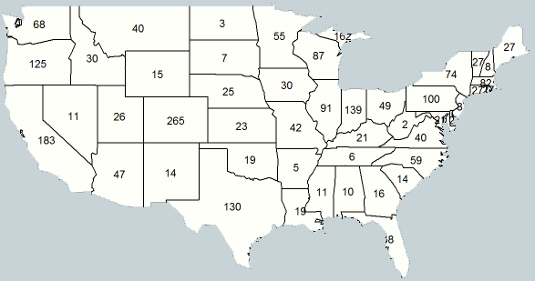
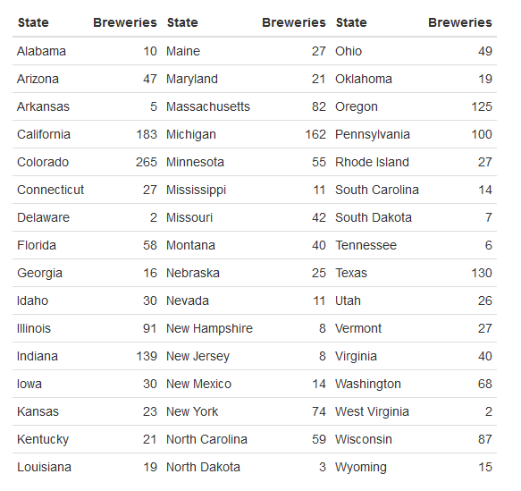
Breweries Per State
BreweryState <- count(dataset_merge,"State")
BreweryState <- BreweryState[-c(1,8,12), ]
BreweryState <- BreweryState[order(BreweryState$State), ]
States <- States[-c(2,11), ]
States <- States[order(States$State), ]
BreweryState$StateLong <- States$StateLong
BrewStateLst <- BreweryState[c(3,2)]
BrewStateLst <- BrewStateLst[order(BrewStateLst$StateLong), ]
colnames(BrewStateLst) <- c("State", "Breweries")
L1 <- BrewStateLst[1:16, ]
L2 <- BrewStateLst[17:32, ]
L3 <- BrewStateLst[33:48, ]
knitr::kable(list(L1, L2, L3), row.names = FALSE)

Slide 8
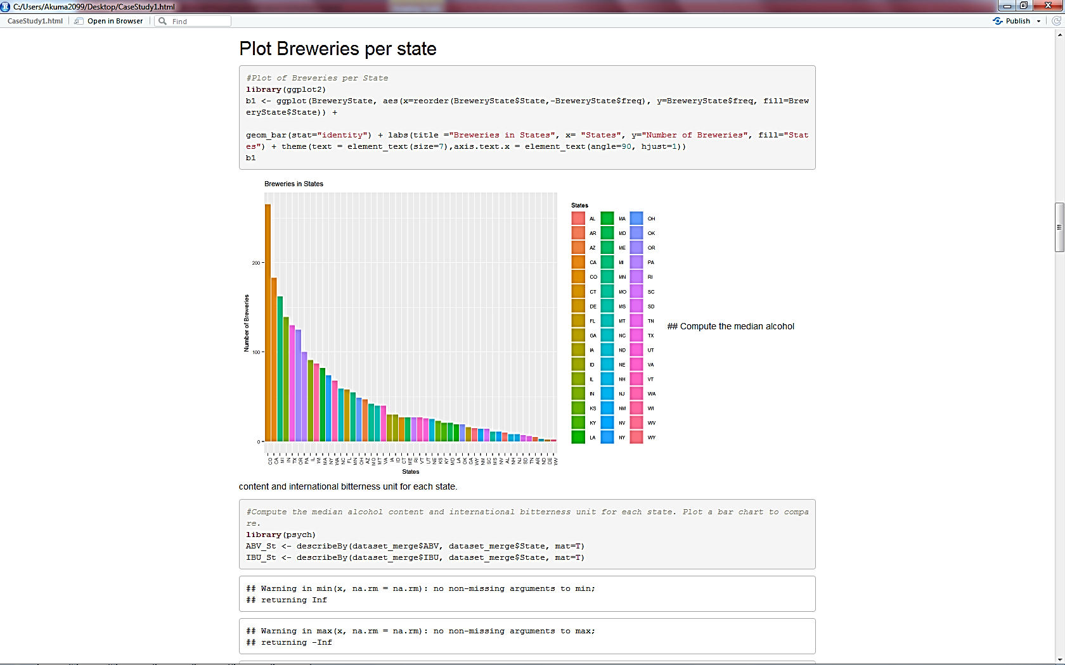
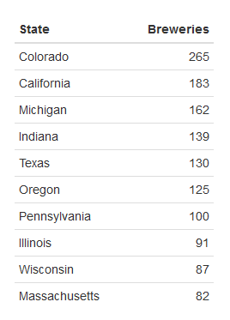
Breweries Per State
library(ggplot2)
b1 <- ggplot(BreweryState,
aes(x=reorder(BreweryState$State,- BreweryState$freq), y=BreweryState$freq, fill=BreweryState$State)) + geom_bar(stat="identity") + labs(title
="Breweries in States", x= "States", y="Number of Breweries", fill="States") + theme(text = element_text(size=7), axis.text.x = element_text(angle=90, hjust=1)) b1

